Slide 2
Build .NET mobile apps quickly and easily with Xamarin.Forms Shell
David Ortinau
Principal Program Manager
david.ortinau@microsoft.com
twitter.com/davidortinau twitch.tv/davidortinau

Slide 3


David Ortinau
Principal Program Manager
Mobile Developer Tools
Xamarin
david.ortinau@microsoft.com

Slide 4
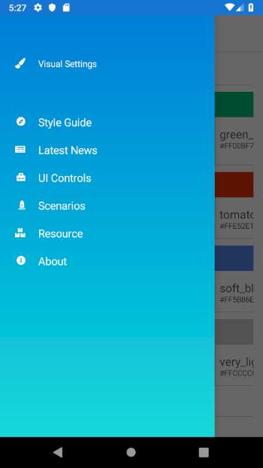
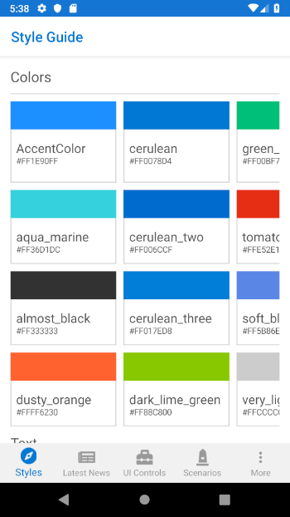
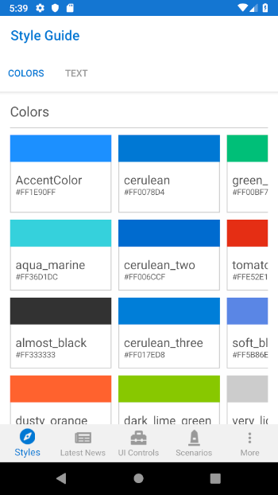
Shell
Notes:
It all starts here with the quickest and easiest way to setup your application.

Slide 5
Tabs Made Simple
<TabbedPage x:Class="App5.Views.MainPage">
<TabbedPage.Children>
<NavigationPage Title="Browse">
<NavigationPage.Icon>
<OnPlatform x:TypeArguments="FileImageSource">
<On Platform="iOS" Value="tab_feed.png"/>
</OnPlatform>
</NavigationPage.Icon>
<x:Arguments>
<views:ItemsPage />
</x:Arguments>
</NavigationPage>
<NavigationPage Title="About">
<NavigationPage.Icon>
<OnPlatform x:TypeArguments="FileImageSource">
<On Platform="iOS" Value="tab_about.png"/>
</OnPlatform>
</NavigationPage.Icon>
<x:Arguments>
<views:AboutPage />
</x:Arguments>
</NavigationPage>
</TabbedPage.Children>
</TabbedPage>
<TabBar>
<Tab Title="Browse" Icon="tab_feed.png">
<ShellContent ContentTemplate="{DataTemplate local:ItemsPage}" />
</Tab>
<Tab Title="About" Icon="tab_about.png">
<ShellContent ContentTemplate="{DataTemplate local:AboutPage}" />
</Tab>
</TabBar>

Slide 6
Flyout Made Simple
public partial class MainPage : MasterDetailPage
{
Dictionary<int, NavigationPage> MenuPages = new Dictionary<int, NavigationPage>();
public MainPage()
{
InitializeComponent();
MasterBehavior = MasterBehavior.Popover;
MenuPages.Add((int)MenuItemType.Browse, (NavigationPage)Detail);
}
public async Task NavigateFromMenu(int id)
{
if (!MenuPages.ContainsKey(id))
{
switch (id)
{
case (int)MenuItemType.Browse:
MenuPages.Add(id, new NavigationPage(new ItemsPage()));
break;
case (int)MenuItemType.About:
MenuPages.Add(id, new NavigationPage(new AboutPage()));
break;
}
}
var newPage = MenuPages[id];
if (newPage != null && Detail != newPage)
{
Detail = newPage;
if (Device.RuntimePlatform == Device.Android)
await Task.Delay(100);
IsPresented = false;
}
}
}
<MasterDetailPage xmlns="http://xamarin.com/schemas/2014/forms"
xmlns:x="http://schemas.microsoft.com/winfx/2009/xaml"
xmlns:d="http://xamarin.com/schemas/2014/forms/design"
xmlns:mc="http://schemas.openxmlformats.org/markup-compatibility/2006"
mc:Ignorable="d"
xmlns:views="clr-namespace:App6.Views"
x:Class="App6.Views.MainPage">
<MasterDetailPage.Master>
<views:MenuPage />
</MasterDetailPage.Master>
<MasterDetailPage.Detail>
<NavigationPage>
<NavigationPage.Icon>
<OnPlatform x:TypeArguments="FileImageSource">
<On Platform="iOS" Value="tab_feed.png"/>
</OnPlatform>
</NavigationPage.Icon>
<x:Arguments>
<views:ItemsPage />
</x:Arguments>
</NavigationPage>
</MasterDetailPage.Detail>
</MasterDetailPage>
<FlyoutItem Title="Browse" Icon="tab_feed.png">
<ShellContent ContentTemplate="{DataTemplate local:ItemsPage}" />
</FlyoutItem>
<FlyoutItem Title="About" Icon="tab_about.png">
<ShellContent ContentTemplate="{DataTemplate local:AboutPage}" />
</FlyoutItem>
<ContentPage xmlns="http://xamarin.com/schemas/2014/forms"
xmlns:x="http://schemas.microsoft.com/winfx/2009/xaml"
xmlns:d="http://xamarin.com/schemas/2014/forms/design"
xmlns:mc="http://schemas.openxmlformats.org/markup-compatibility/2006"
mc:Ignorable="d"
x:Class="App6.Views.MenuPage"
Title="Menu">
<StackLayout VerticalOptions="FillAndExpand">
<ListView x:Name="ListViewMenu"
HasUnevenRows="True">
<d:ListView.ItemsSource>
<x:Array Type="{x:Type x:String}">
<x:String>Item 1</x:String>
<x:String>Item 2</x:String>
</x:Array>
</d:ListView.ItemsSource>
<ListView.ItemTemplate>
<DataTemplate>
<ViewCell>
<Grid Padding="10">
<Label Text="{Binding Title}" d:Text="{Binding .}" FontSize="20"/>
</Grid>
</ViewCell>
</DataTemplate>
</ListView.ItemTemplate>
</ListView>
</StackLayout>
</ContentPage>
menuItems = new List<HomeMenuItem>
{
new HomeMenuItem {Id = MenuItemType.Browse, Title="Browse" },
new HomeMenuItem {Id = MenuItemType.About, Title="About" }
};
ListViewMenu.ItemsSource = menuItems;
ListViewMenu.SelectedItem = menuItems[0];
ListViewMenu.ItemSelected += async (sender, e) =>
{
if (e.SelectedItem == null)
return;
var id = (int)((HomeMenuItem)e.SelectedItem).Id;
await RootPage.NavigateFromMenu(id);
};

Slide 7
Show Me Code!
github.com/davidortinau/FlyMe

Slide 8
<Shell>
<FlyoutItem
Title="Style Guide"
Icon="Compass.png">
<ShellContent
ContentTemplate="{DataTemplate p:StyleGuidePage}"/>
</FlyoutItem>
</Shell>
Shell
Notes:
It all starts here with the quickest and easiest way to setup your application.

Slide 9
<Shell>
<TabBar>
<Tab
Title="Styles"
Icon="Compass.png">
<ShellContent
ContentTemplate="{DataTemplate
p:StyleGuidePage}"/>
</Tab>
</TabBar>
</Shell>
Shell
Notes:
It all starts here with the quickest and easiest way to setup your application.

Slide 10
<Shell>
<TabBar>
<Tab
Title="Style Guide"
Icon="Compass.png">
<ShellContent
Title="Colors"
ContentTemplate="{DataTemplate p:ColorsPage}"/>
<ShellContent
Title="Text"
ContentTemplate="{DataTemplate p:TextPage}"/>
</Tab>
</TabBar>
</Shell>
Shell
Notes:
It all starts here with the quickest and easiest way to setup your application.

Slide 11
CityListPage
CityDetailPage
Shell.Current
.GoToAsync($"detail?id={city.id}");
Shell Navigation Service
Notes:
It all starts here with the quickest and easiest way to setup your application.

Slide 12
CityListPage
CityDetailPage
[QueryProperty("CityId", "id")]
public partial class CityDetailPage : ContentPage
{
public CityDetailPage()
{
InitializeComponent();
}
public string CityId
{
set
{
// do something with the Id
}
}
}
Shell Navigation Service
Notes:
It all starts here with the quickest and easiest way to setup your application.

Slide 13
Thanks!
David Ortinau
Principal Program Manager
Mobile Developer Tools
Xamarin
david.ortinau@microsoft.com

